Slide 1
WOW2GO
Ivan Zhang
Aakash Sham
John Adamson
Ricardo Ybarra

Slide 2
WOW2Go?
Gratification on the go
Rewards for healthy purchases you already make
Easy as 1, 2, 3
Scan Receipt
Hit Upload
Receive WOW points from Humana

Slide 3
The Values
Inspire Health
Cultivate Uniqueness
Pioneer Simplicity

Slide 4
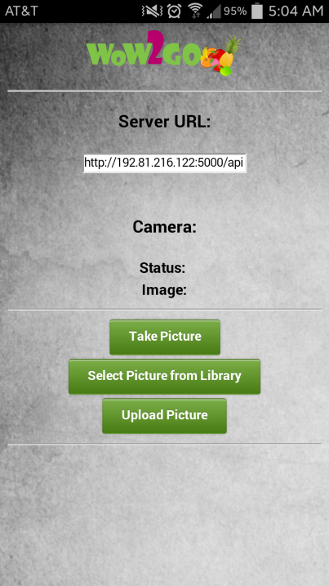

Slide 5
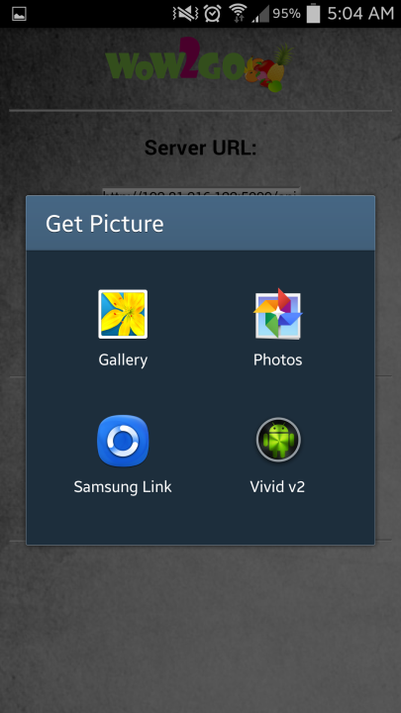
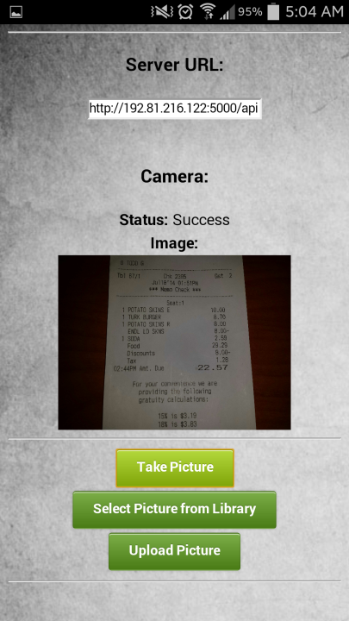


Slide 6
